Slide 1
Entity Framework Core 2.0
31-Mar-18 | Start
Appendix
Online

Slide 2
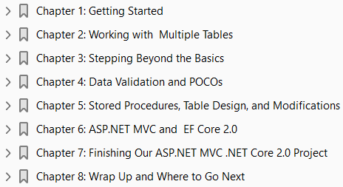
EF Core 2.0
Ch | Date
1 | ddmmmyy
2
3
4
5
6
7
8
Beginning Entity Framework Core 2.0 Mar 2018

Slide 3
1
Getting Started

Slide 4
Intro
We are going to jump right into an example, as I think that is the best way to learn something.
As we cover new topics, we explain them as we work on them.
This is better than a general overview at the start of the chapter or section, because that won’t mean much to you while you are reading it.
I personally dislike it when books show you the wrong way of doing something and then show you how to do it “correctly” after you just spent five minutes typing in the wrong way, so I’m not going to do that to you.
However, I do explain why we are doing something and explain what would be wrong.
Since this is a “getting started” type of book, all the examples work as written, although they may not be the best way of getting it done.
As you get more comfortable with this technology and as your skills grow, you’ll come up with your own way of doing things.
I’m just here to help you started down the path to greatness.
For those of you who are like me and skipped the Introduction, you should be using the latest build of Visual Studio 2017 and at least .NET Framework 4.6.1.
At the time of this writing, the latest build of Visual Studio was 15.3.3 with the .NET Framework build 4.7.02046. These build numbers can be found in the Visual Studio About window.

Slide 5
What Is .NET Core
Let’s take a quick moment to cover something that some of you may be wondering— what is the difference between .NET and .NET Core?
First off, .NET Core is cross platform, so if you want to run an application on Windows, Linux, or Mac, .NET Core is your tool. Due to its compact nature, .NET Core also gives better performance.
The other nice thing is that you can always start with .NET Core and, if you find you need more features, you can switch to the full version of the .NET Framework.
This is especially true if you are writing a service.
The application created here is used throughout the first section of this book and each section builds off the last, so you really can’t skip around.
With that being said, let’s get started!

Slide 6
Setting Up Your Application

Slide 7
Creating the Database and Tables (Entities)

Slide 8
Creating the Database

Slide 9
Adding Data to a Table

Slide 10
Retrieving Data from a Database and Displaying It

Slide 11
Deleting Data from a Database

Slide 12
Deleting a Single Record

Slide 13
Deleting Multiple Records

Slide 14
Updating Data in a Table

Slide 15
2
Working with Multiple Tables

Slide 16
Intro

Slide 17
3
Stepping Beyond the Basics

Slide 18
Intro

Slide 19
4
Data Validation and POCOs

Slide 20
Intro

Slide 21
5
Stored Procedures, Table Design, and Modifications

Slide 22
Intro

Slide 23
6
ASP.NET MVC and EF Core 2.0

Slide 24
Intro

Slide 25
7
Finishing Our ASP.NET MVC .NET Core 2.0 Project

Slide 26
Intro

Slide 27
8
Wrap Up and Where to Go Next

Slide 28
Intro

